Slide 1
Chapter 16
Database Administration and Security

Slide 2
Learning Objectives
In this chapter, you will learn:
That data are a valuable business asset requiring careful management
How a database plays a critical role in an organization
That the introduction of a DBMS has important technological, managerial, and cultural consequences for an organization
About the database administrator’s managerial and technical roles

Slide 3
Learning Objectives
In this chapter, you will learn:
About data security, database security, and the information security framework
About several database administration tools and strategies
How cloud-based data services impact the DBA’s role
How various technical tasks of database administration are performed with Oracle

Slide 4
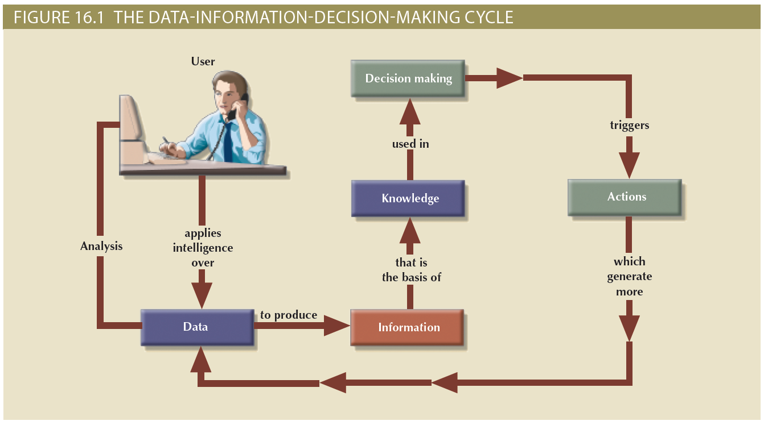
Figure 16.1 - The Data-Information-Decision Making Cycle

Slide 5
Data
Dirty data
Data that suffer from inaccuracies and inconsistencies
Data quality
Ensuring accuracy, validity, and timeliness of data
Data profiling software
Determine data patterns and compare them against standards defined by the organization
Master data management (MDM) software
Helps prevent dirty data by coordinating across multiple systems

Slide 6
Need for and Role of a Database in an Organization
At the top management level
Enable strategic decision making and planning
Identify growth opportunities
Define and enforce organizational policies
Reduce costs and boost productivity
Provide feedback
At the middle management level
Deliver the data required for tactical planning
Monitor the use of resources
Evaluate performance
Enforce security and privacy of data in the database
At the operational management level
Represent and support company operations
Produce query results within specified performance levels
Enhance the company’s short-term operations

Slide 7
Introduction of a Database: Special Considerations
Technological aspect
Selecting, installing, configuring, and monitoring the DBMS to ensure that it operates efficiently
Managerial aspect
Careful planning to create an appropriate organizational structure
Cultural aspect
Listening to people’s concerns about the system and explaining its uses and benefits

Slide 8
Evolution of the Database Administration Function
Information systems (IS) department
Provides end users with data management support and solutions for information needs
Database administrator
Responsible for control of the centralized and shared database
Systems administrator
General coordinator of all DBAs
Data administrator (DA) or information resource manager (IRM)
Has a higher degree of responsibility and authority than the DBA

Slide 9
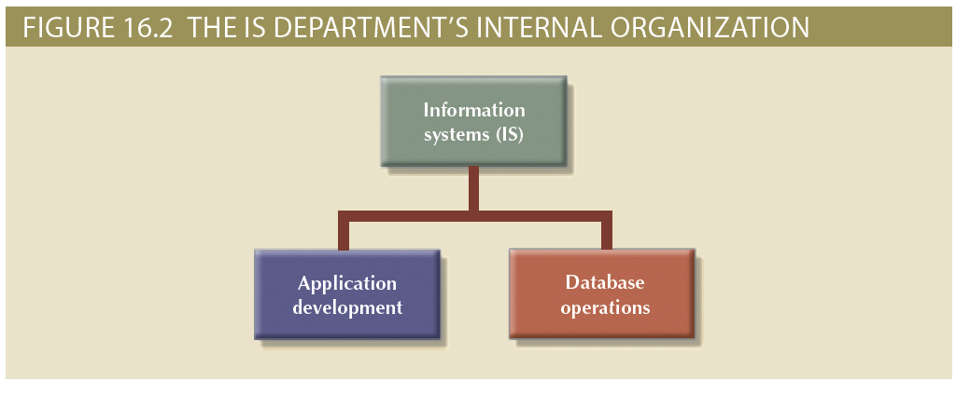
Figure 16.2 - The IS Department’s Internal Organization

Slide 10
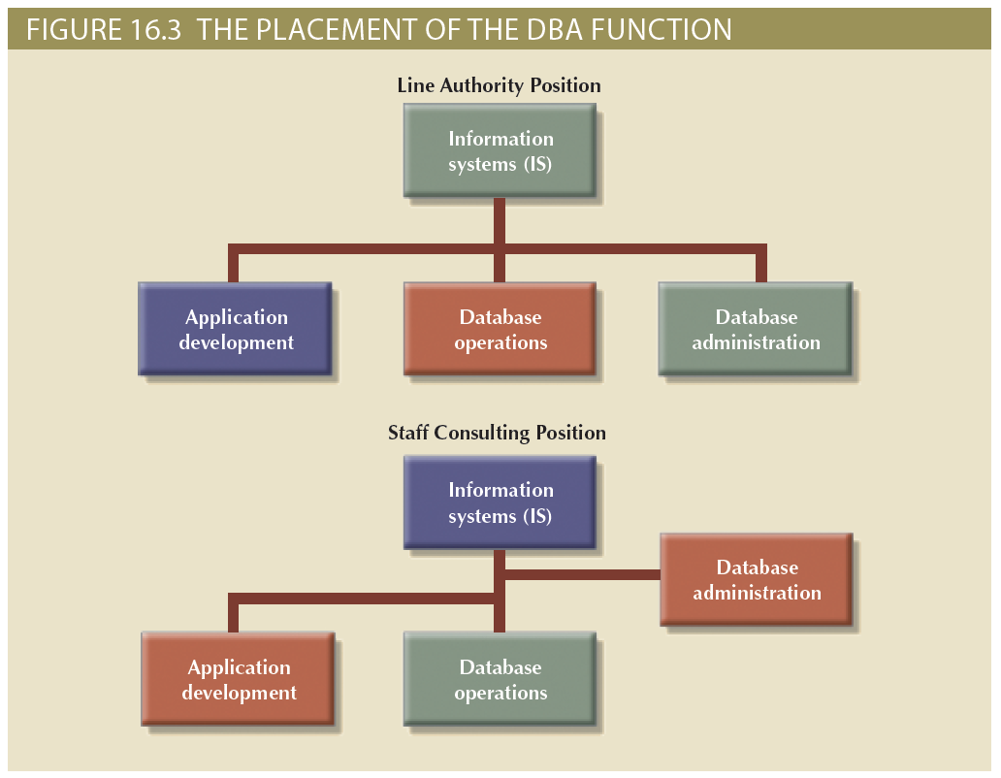
Figure 16.3 - The Placement of the DBA Function

Slide 11
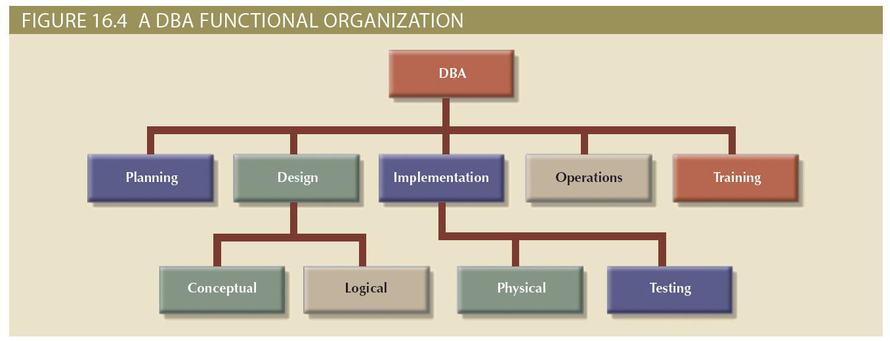
Figure 16.4 - A DBA Functional Organization

Slide 12
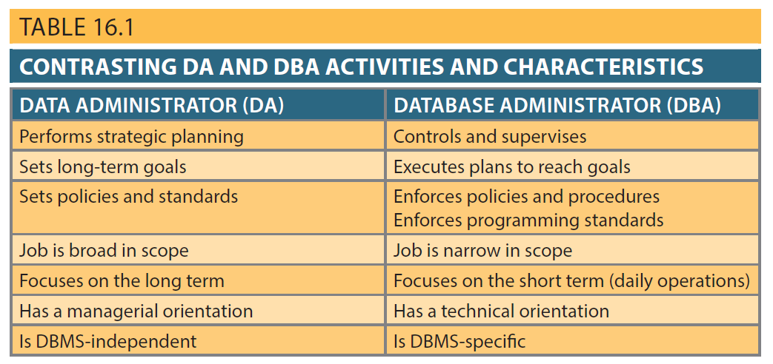
Table 16.1 - Contrasting DA and DBA Activities and Characteristics

Slide 13
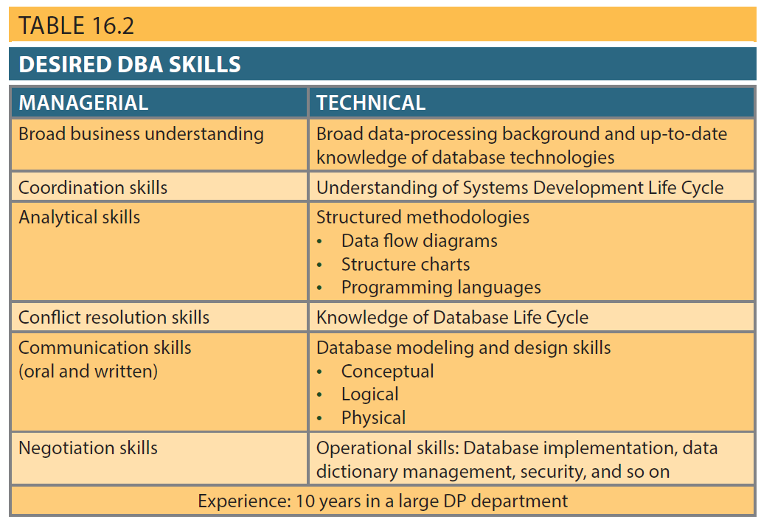
Table 16.2 - Desired DBA Skills

Slide 14
DBA’s Managerial Role
Provide end-user support
Enforce policies, procedures, and standards for correct data creation, usage, and distribution within the database
Manage data security, privacy, and integrity
Manage data backup and recovery
Fully recover data in case of data loss
Database security officer (DSO): Ensures database security and integrity

Slide 15
DBA’s Managerial Role
Disaster management: Planning, organizing, and testing of database contingency plans and recovery procedures
Backup and recovery measures must include at least periodic data and application backups:
Full backup or database dump: Produces a complete copy of the entire database
Incremental backup: Produces a backup of all data since the last backup date
Concurrent backup: Takes place while the user is working on the database

Slide 16
DBA’s Managerial Role
Backup and recovery measures must include at least:
Proper backup identification
Convenient and safe backup storage
Physical protection of both hardware and software
Personal access control to the software of a database installation
Insurance coverage for the data in the database

Slide 17
DBA’s Managerial Role
Additional points:
Data recovery and contingency plans must be tested, evaluated and practiced frequently
Backup and recovery plan not likely to cover all information system components
Ensure data is distributed to the right people at the right time and in the right format

Slide 18
DBA’s Technical Role
Evaluate, select, and install DBMS and related utilities
Design and implement databases and applications
Test and evaluate databases and applications
Operate the DBMS, utilities, and applications
Train and support users
Maintain the DBMS, utilities, and applications

Slide 19
Security Goals
Confidentiality: Protecting data against unauthorized access
Compliance: Activities that meet data privacy and security reporting guidelines
Integrity: Keeping data consistent and free of errors or anomalies
Availability: Accessibility of data whenever required by authorized users and for authorized purposes

Slide 20
Security Policies
Collection of standards, policies, and procedures created to guarantee security
Ensures auditing and compliance
Security audit process
Identifies security vulnerabilities
Identifies measures to protect the system

Slide 21
Security Vulnerabilities
Weakness in a system component that could allow unauthorized access or cause service disruptions
Categories: Technical, managerial, cultural, and procedural
Security threat: Imminent security violation
Security breach: Occurs when a security threat is exploited and could lead to a database whose integrity is preserved or corrupted

Slide 22
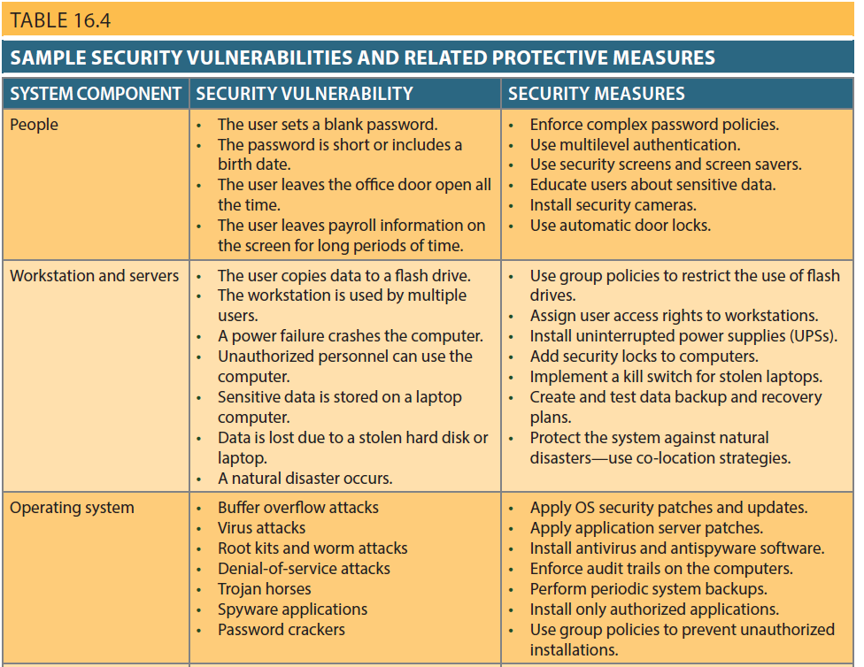
Table 16.4 - Sample Security Vulnerabilities and Related Protective Measures

Slide 23
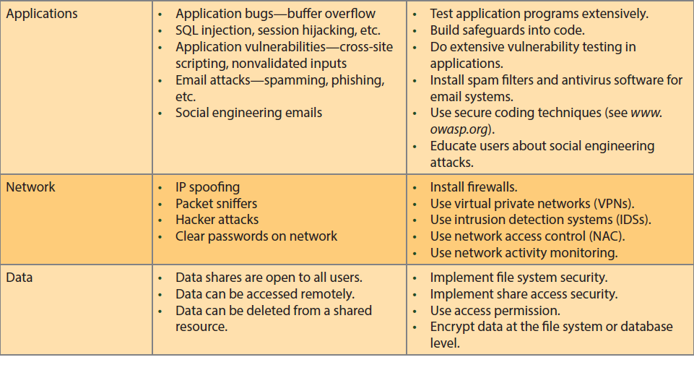
Table 16.4 - Sample Security Vulnerabilities and Related Protective Measures

Slide 24
Database Security
DBMS features and related measures that comply with the security requirements
Authorization management: Procedures to protect database security and integrity
User access management
View definition
DBMS access control
DBMS usage monitoring
Audit log: Automatically records description of database operations performed by all users

Slide 25
Database Administration Tools
Database monitoring
Database load testing
Database performance tuning
SQL code optimization
Database bottleneck identification and remediation
Database modeling and design
Database data extraction, transformation, and loading

Slide 26
Data Dictionary
Two main types:
Integrated - Included with the DBMS
Standalone - Third-party systems
Active data dictionary: Automatically updated by the DBMS with every database access
Passive data dictionary: Requires running a batch process
Main function - Store description of all objects that interact with the database

Slide 27
Data Dictionary
Key element of information resource management
Can be described as the information resource dictionary
Metadata is the basis for monitoring database use and for assigning access rights to users
DBA uses data dictionary to support data analysis and design

Slide 28
Computer-Aided Systems Engineering (CASE) Tools
Automated framework for the Systems Development Life Cycle (SDLC)
Use structured methodologies and powerful graphical interfaces
Classified according to extent of support provided:
Front-end CASE tools: Provide support for the planning, analysis, and design phases
Back-end CASE tools: Provide support for the coding and implementation phases

Slide 29
Components of a CASE Tool
Graphics
Screen painters and report generators
Integrated repository
Analysis segment
Program documentation generator

Slide 30
Developing a Data Administration Strategy
Information engineering (IE): Translates strategic goals into data and applications
Information systems architecture (ISA): Helps plan, develop, and control future information systems
Critical success factors:
Management commitment and defined standards
Thorough analysis of the company situation
End-user involvement
Training and a small pilot project

Slide 31
DBA’s Role in the Cloud
Significant impact on role of DBAs
Tasks split between internal DBA and cloud service provider
Cloud service partner company provides:
DBMS installation and updates
Server/network management
Backup and recovery operations

Slide 32
Oracle Database Administration Tools
Ensure the RDBMS starts automatically
Create tablespaces and datafiles
Tablespace: Logical storage space
Datafile: Physically stores the database’s data
Manage users and establish security
User: Allows a given person to log on to the database
Role: Authorizes a user to connect to the database and use its system resources
Profile: Controls how much of the database resource a given user can access

Slide 33
Types of Tablespace
SYSTEM
Stores the data dictionary data
USERS
Stores the table data created by the end users
TEMP
Stores the temporary tables and indexes created during the execution of SQL statements
UNDOTBS1
Stores database transaction recovery information

Slide 34
Customize Database Initialization Parameters
Fine-tuning a database is an important task that usually requires modification of parameters
Initialization parameters reserve resources used by the database at run time
After modifying parameters database restart may be required

